Slide 1
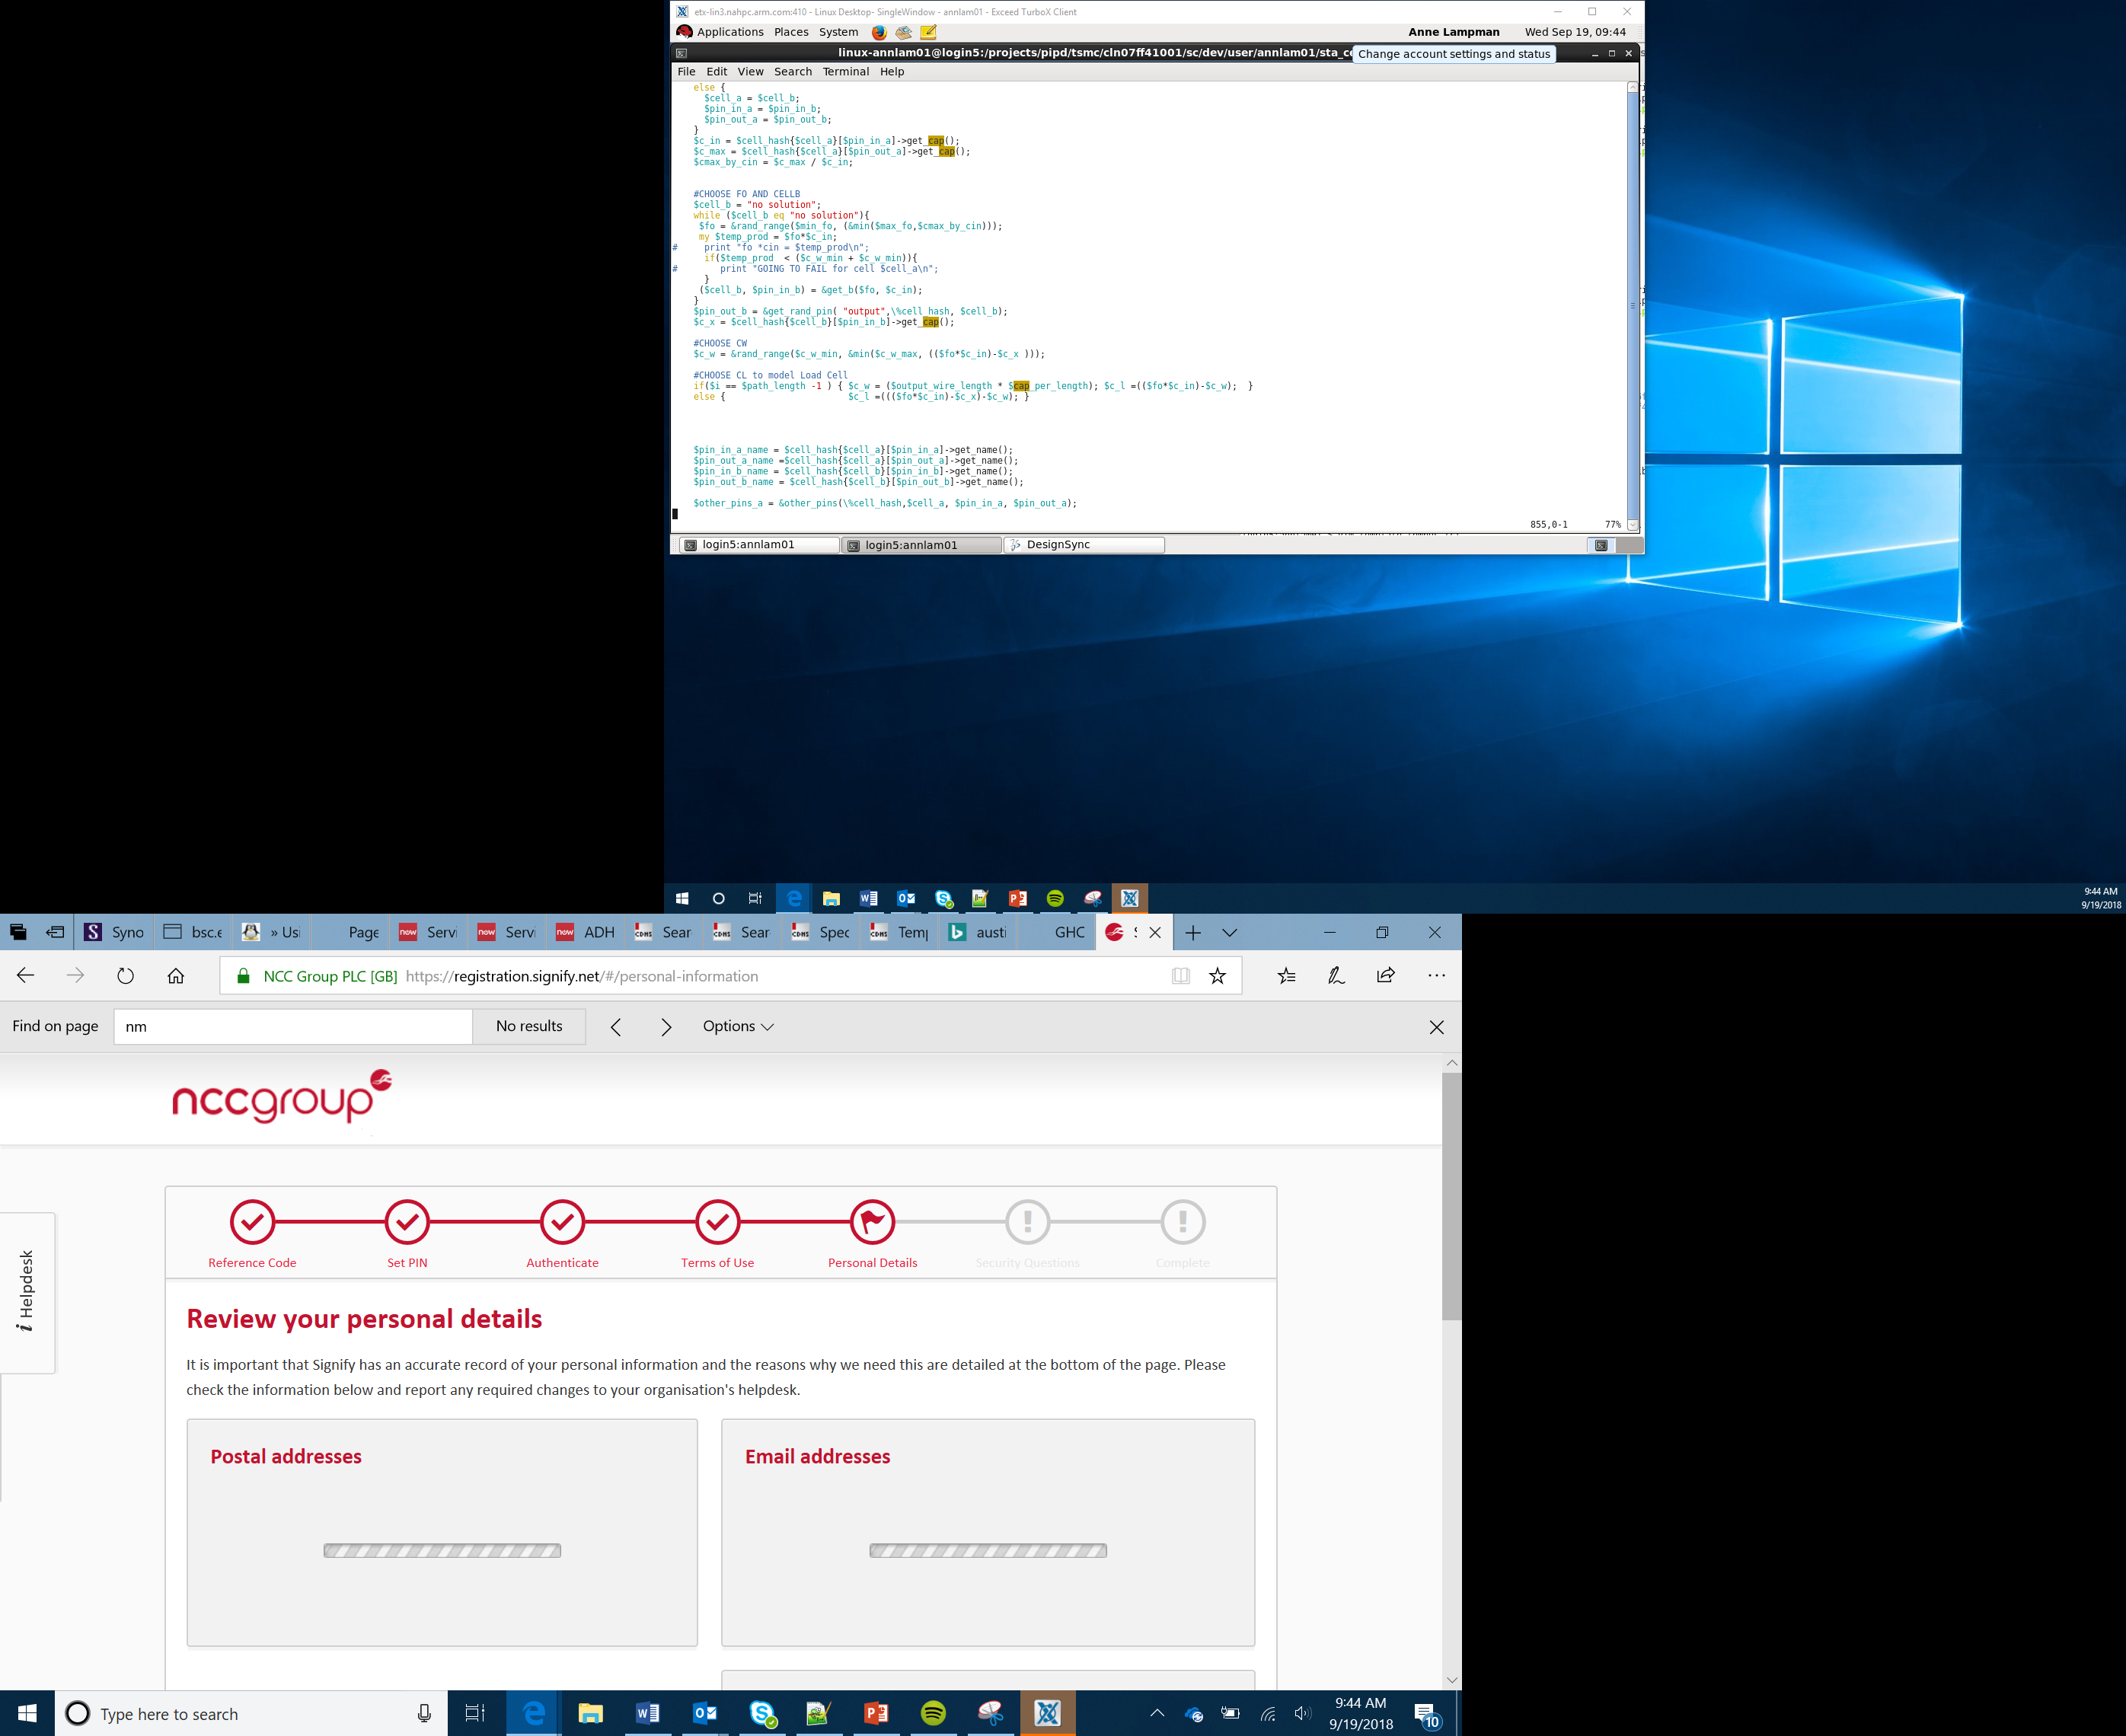

Bit:Bot Race Car Project
Branding
Lesson 8

Slide 2
Objectives
Apply your understanding of computational thinking and programming skills to achieve a goal
Understand why branding is important
Develop a logo and brand idea for you racing team

Slide 3
Bit:Bot Race Car
The Challenge
You are going to take part in the LOWGEAR robot race, it will be your challenge to build and modify your Bit:Bot robot car to race around a robot race track and complete a series of challenges.
Notes:
Introduce the overall project of the robot race car
Explain how we will look at pre-programmed, remote controlled and self-drive versions in our solutions and there challenge will be to produce a self-driving car that is marketable to the general public

Slide 4

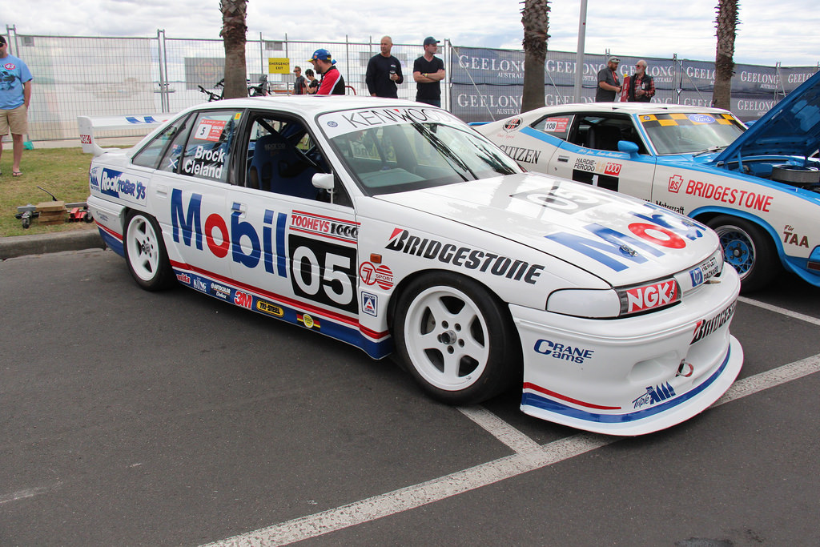


Branding
Branding is important – It is how a business gets recognised
The logo is the most important element of the branding
A good brand will encourage customers to buy
A professional appearance and well developed branding will build trust with customers old and new
Your logo gives your business or project its identity: the logo is the visual building block of your brand
Think about all those sports and clothing logos you wear. The most memorable logos and brands are simple and stick in your mind
Notes:
Royalty free or stock photos of race cars imagery is needed here as well as some common sports logo and brands
The logos here all came up on a search filtered as reuse with modification (even commercial)
Explain how branding is important, how this is not only how our brand gets recognised but also can lead to other forms of income through sponsorship
Use common examples of how some brands have worked themselves into our every day lives and become instantly recognisable. Eg MacDonald's, Nike, Etc
Remind students that logos need to be simple, this makes them easy to remember and cheap to reproduce
It shouldn’t be reliant on colour as logos are often reproduced in black and white
Work through the worksheet with students and use the design template for headings

Slide 5
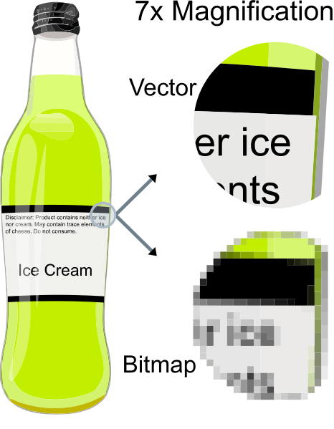
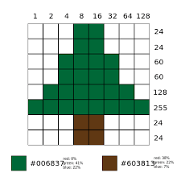
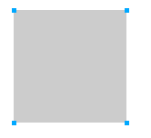
Vector and Bitmap Graphics
Bitmap
A bitmap image is made up lots of coloured squares
Vector
A Vector image uses coordinates to define a shape
Vectors are scalable, meaning they can be made bigger without losing clarity

Slide 6
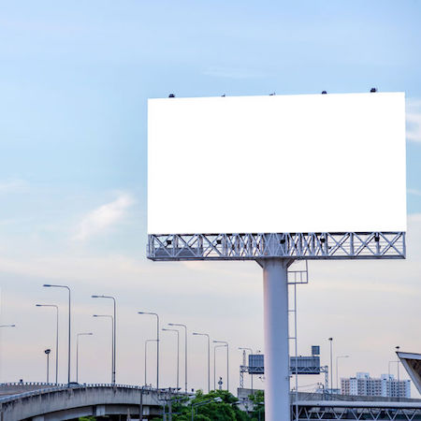

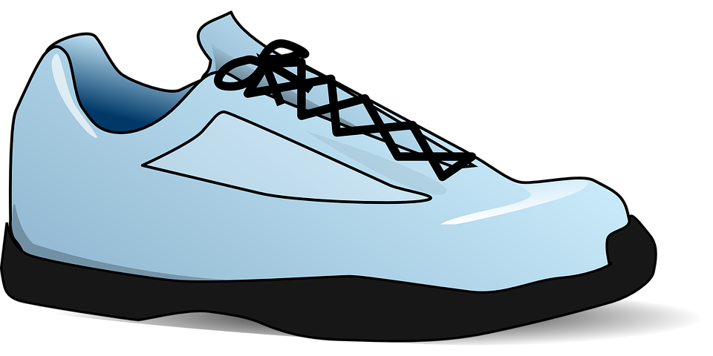
Bitmap = not scalable
Vector = scalable

Slide 7
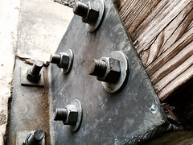



Which are bitmap or vector?

